Slide 1

Project Team:4
Ashish Bachuwar
Rekha Rani
Keming Cui

Slide 2

Project Repo
https://github.com/Ash-Harley/Project-Management
Table of Content
1
Project Purpose
1
2
2
Netflix
Competitors Understanding
3
3
Where We Are Right Now
4
4
Hybrid Approach
6
5
5
Netflix Worldwide
6
Conclusion

Slide 3
Netflix aims to level up the entertainment experience by adding live streaming to its platform for its global consumers by utilizing a $1 billion budget in the next 2 years.
Project Purpose
Project Objective
Launch a $1 billion live-streaming feature in 2 years, attracting 15 million users in 6 months with high-quality content and advanced technology.
Stream 300 global events in the first year with a $500 million budget, covering music, sports, and gaming.
Increase Netflix subscribers' daily content watch time from 3.2 to 5 hours in one year with a $500 million investment in personalized live-streaming entertainment.
Project Goals
The critical path takes 248 days to complete the project.
The schedule has 26 tasks and 96 work packages.
Project categories and tasks have dependencies.
NETFLIX VISION
Becoming the best global entertainment distribution service
Project Schedule
Design - $170,000,000 Testing – 119,250,000
Development -$209,900,000 Launch - $77,003,340
Integration - $179,850,000 Contingency - $123,906,680
Content Partnership - $120,090,000 Total Budget = $ 1Billion
Project Budget
Project Risks
Global streaming restriction may hinder Netflix's worldwide entertainment goal.
Uncertain user adoption may impact the success of the live-streaming feature.
Legal risks include content licensing, copyright issues, and regional laws restrictions.

Slide 4
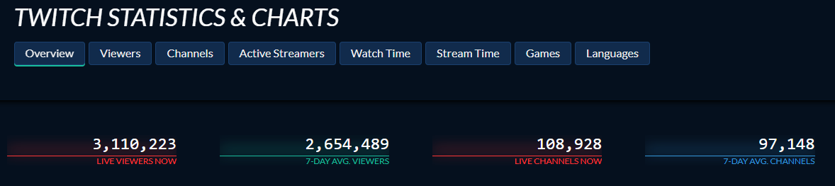
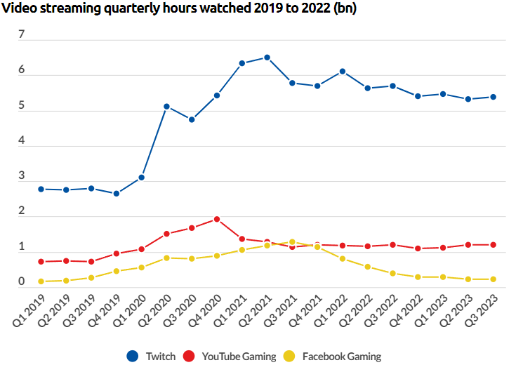

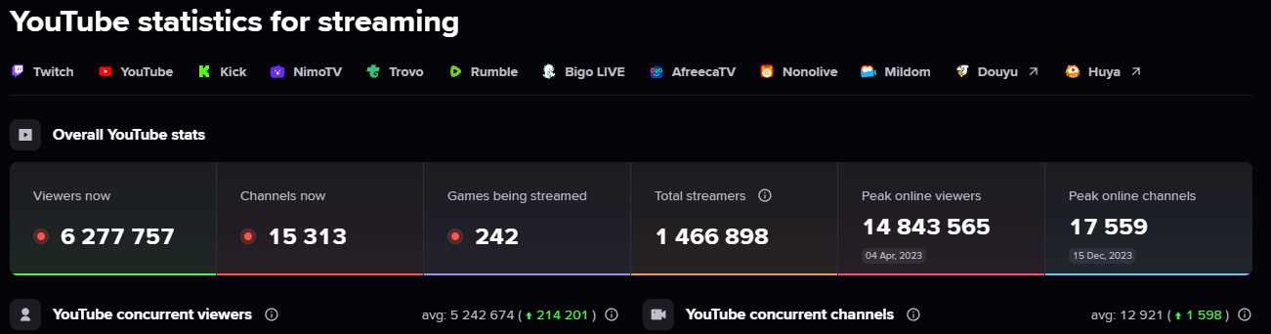
Competitors Understanding
Twitch had 33.2 million users which generated 2.8 billion in 2022.
Netflix has 7 times more users than Twitch.
YouTube had 2.68 billion users that generated 29.24 billion in 2022.
Netflix has 11 times less users than YouTube, but more annual revenue in 2022 i.e., $ 31.7 billion.
Twitch users touched 6+ billion quarterly video streaming watch hours.
YouTube reached the 2 billion mark in Q4 2020.
Facebook reached just above the 1+ billion mark in Q3 2021.

Slide 5
Where We Are Right Now
Consistent increase in annual revenue but dropped in 2023 drastically.
Question – What product should we aim for next so that the revenue never stumbles?
Annual revenue growth consistently declined since 2018.
Question – The current projects may not be catering to the overall growth, what can we do differently?
Ratio of number of Netflix users by target market size.
Only 3 countries have a good penetration rate of above 50%.
Question – Only 10 / 195 countries have a >20% penetration rate. How do we achieve our Vision by attracting other countries?
Question –
The consistent increase is good but is nowhere close to the company’s Mission and Vision. What project can get us there?

Slide 6
Hybrid Approach
Charter: Identify resources, timelines, and milestones.
Scope: Foundation for planning.
Project Schedule: Development of milestones, dependencies, and resource allocation.
Budget: 1) Preliminary cost estimates, 2) Potential cost drivers, 3) Allocate funds for each phase.
Risks: 1) Potential threats and opportunities, 2) Risk response strategies and contingency plans.
RACI & Comm Plan: 1) Defining roles and responsibilities, 2) Ensure accountability, and 3) Identify key stakeholders.
WBS: Break tasks into work packages.
Project Charter & Scope: 1) Validate project outcomes with the project charter and scope. 2) Basis for post-launch improvements.
WBS: 1) Monitor and control, 2) Verify the completion of project deliverables.
Budget: 1) Complete financial transactions, 2) Assess project cost Vs budget allocated.
Risks: Contingency plans to mitigate launch-related risks.
Waterfall
Requirements
Launch
Project Charter & Scope: Basis for test case creation.
Project Schedule: Time estimates for testing activities.
Budget: Accommodate any additional testing requirements.
Risks: Identify and evaluate risks related to data integrity and system failures.
Planning
Agile
Project Charter: 1) Project objectives, 2) Project team, 3) Key stakeholders, and 4) High-level milestones.
Scope: 1) Defining the boundaries, 2) Features, 3) Acceptance criteria, and 4) Functionalities.
Design
Testing
Project Charter & Scope: Reference to validate design decisions and approvals.
Budget: Validate decisions based on budget constraints, 2) Make informed trade-offs.
Risks: 1) Identify design-related risks, 2) Risk mitigation measures.
Development
WBS and Project Schedule: Provide a timeline for task development.
RACI & Comm Plan: 1) Monitor and adjust responsibilities, 2) Identify gaps, and 3) Foster collaboration and transparency.
WBS: 1) Assign tasks and responsibilities, 2) Track the progress of work packages.
Budget: 1) Resource allocation and expenditure tracking, 2) Cost controls.
Risks: 1) Assess development-specific risks, 2) Risk response plan for risks found.

Slide 7
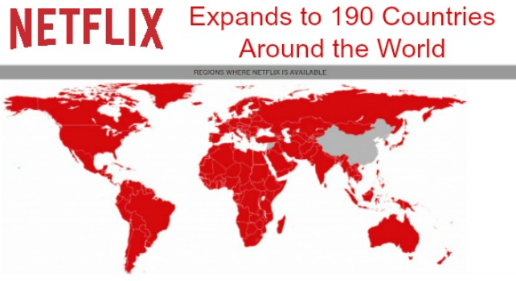
Netflix Worldwide
Utilize the existing user base in 190 countries.
This helps mitigate the risks since region-specific content is already followed.
Content Partners may already be our subscribers.

Slide 8
Conclusion
Revolutionizing Entertainment: The Netflix Live-Streaming project introduces groundbreaking live experiences, elevating traditional streaming and enhancing user engagement.
Strategic Objectives for Growth: Aligned with Netflix's goals, the project focuses on attracting 15 million new users and increasing average content watch time, strategically driving user base expansion and loyalty.
Comprehensive Scope: Encompassing live streaming, content partnerships, user engagement features, and community guidelines, the project takes a holistic approach to entertainment delivery on the Netflix platform.
Financial Commitment and Investment: With a $1 billion investment covering infrastructure, content licensing, feature development, marketing, and support, Netflix demonstrates a substantial commitment to the success of the Live-Streaming project.
Competitor Insights and Market Dynamics: Benchmarking against Twitch and YouTube reveals the vast potential in the live streaming market, positioning Netflix strategically to tap into this lucrative segment.

Slide 9

Any Questions

